Slide 1
Dynamic Programming

Slide 2
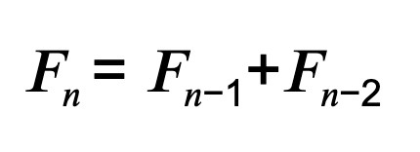
Fibonacci Sequence

Slide 3
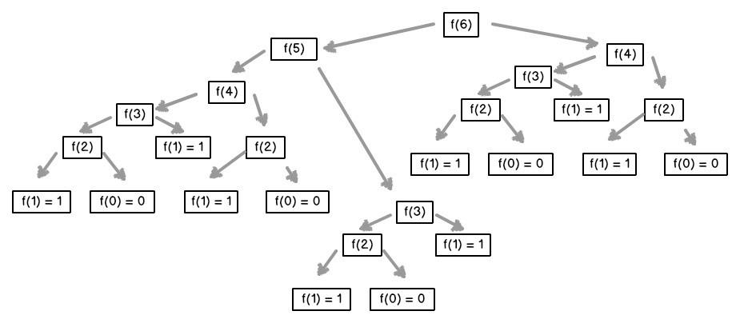
Getting Fibonacci number 6

